Slide 1
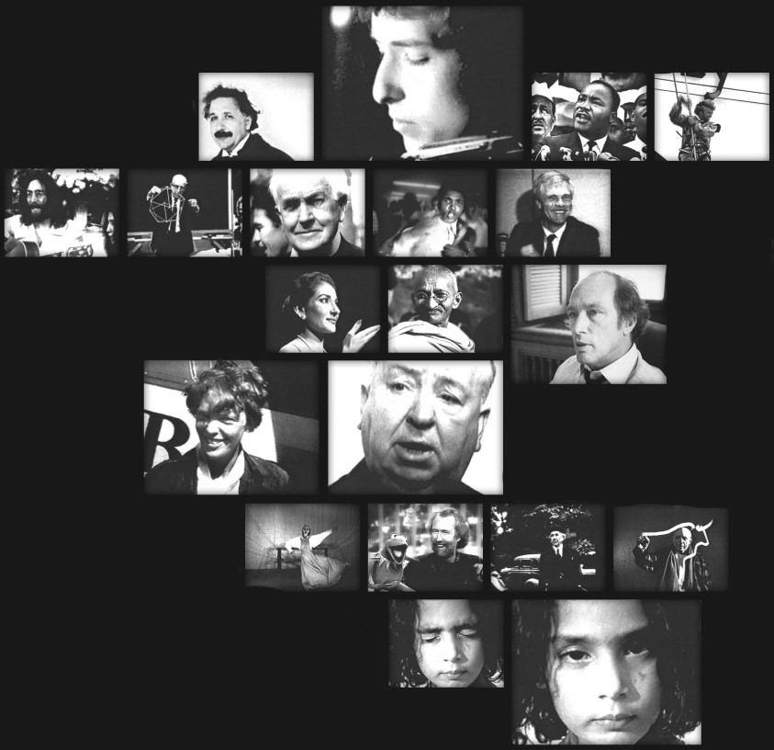
First Semester Project Single User System

Slide 2

Group 6 - Nucleus Software -
Group Members:
Gais El-AAsi
Deivydas Zibkus
Marcel Notenboom
Lukas Vaisnoras

Slide 3
Table of contents
Requirements
Analysis
Design
Implementation & Test
Conclusion & Future
Process Report
Q & A

Slide 4

1.
Requirements

Slide 5


Requirements
Functional
The system must be able display all 4 sheets
The system must update stored information about the employees and analysis
The team leader must be able to view / edit the sheets individually
Team Leader can cancel any process at any time
Non - Functional
The main programing language of the system must be JAVA;
The system must be a single user software;
The system must offer graphic user interface (not command-line);
The system must store data for at least one year;

Slide 6

2. Analysis

Slide 7
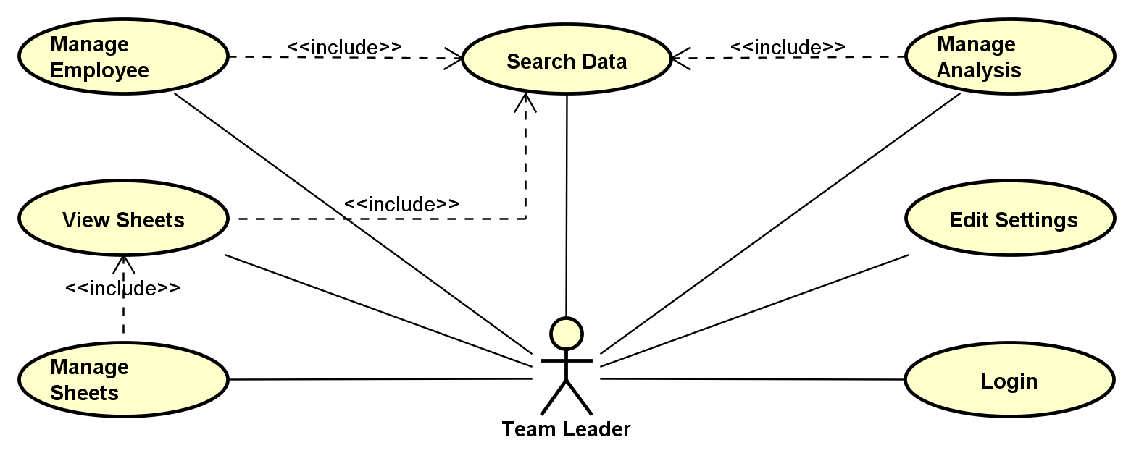
Use Case Diagram
Use Case
Diagram
Use Case Description
Activity Diagram

Slide 8
Use Case Description
Item | Value
Use Case | Manage Sheets
Summary | Team Leader Modifies data in the sheet/sheets;
Actor | Team Leader
Precondition | Team Leader needs to be logged in; The Use Case uses Search Data Use Case; Must be in a sheet to modify data;
Post condition | Data in the desired sheet/sheets is modified;
Base Sequence | Choose data to be edited; Team Leader edits desired data; System checks for errors; Data is stored;
Branch Sequence | None
Exception Sequence | Employees are double booked: 1. - 3. same as Base Sequence; 4. Displays message about double booking; Go back to step 2; Employee on vacation is put on a analysis: 1. - 3. same as Base Sequence; 4. Displays message about employee being on vacation; Go back to step 2; Not enough personal on an analysis: 1. - 3. same as Base Sequence; 4. Displays message about not enough personal on an analysis; Go back to step 2; More employees added to an analysis than required: 1. - 3. same as Base Sequence; 4. Displays message about too many employees; Go back to step 2; Missing non-optional data for the employee: 1. - 3. same as Base Sequence; 4. Displays message about missing non-optional; Go back to step 2; Team Leader tries to add/edit an analysis causing two identical analysis in the system: 1. - 3. same as Base Sequence; 4. Displays message identical analysis; Go back to step 2;
Sub Use Cas | View Sheets;
Note | The process can be cancelled at any time;

Slide 9
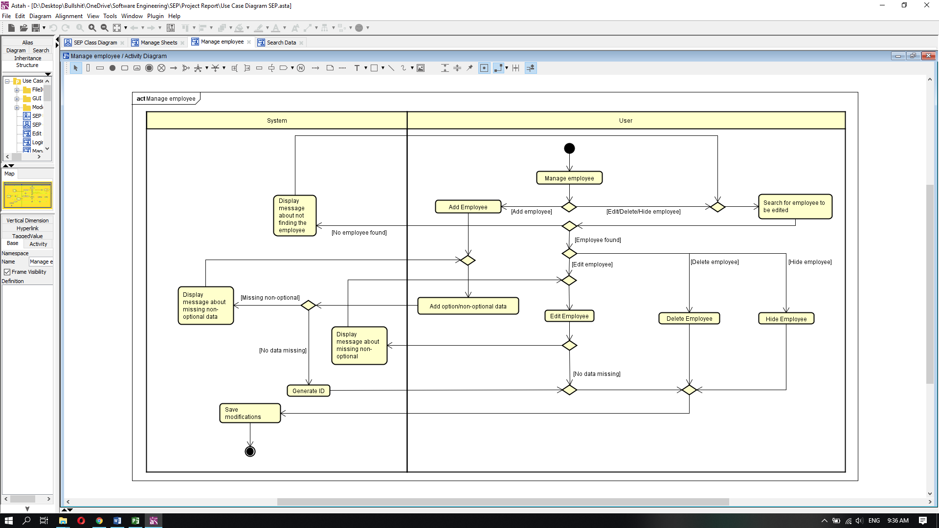
Activity Diagram

Slide 10
3. Design

Slide 11
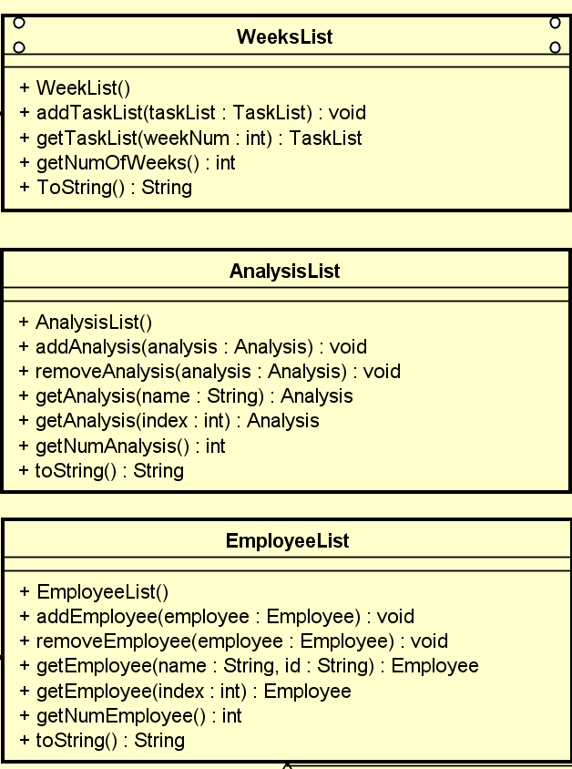
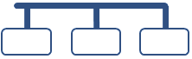
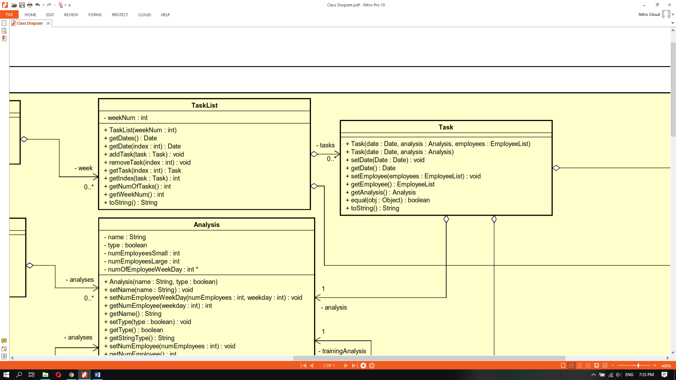
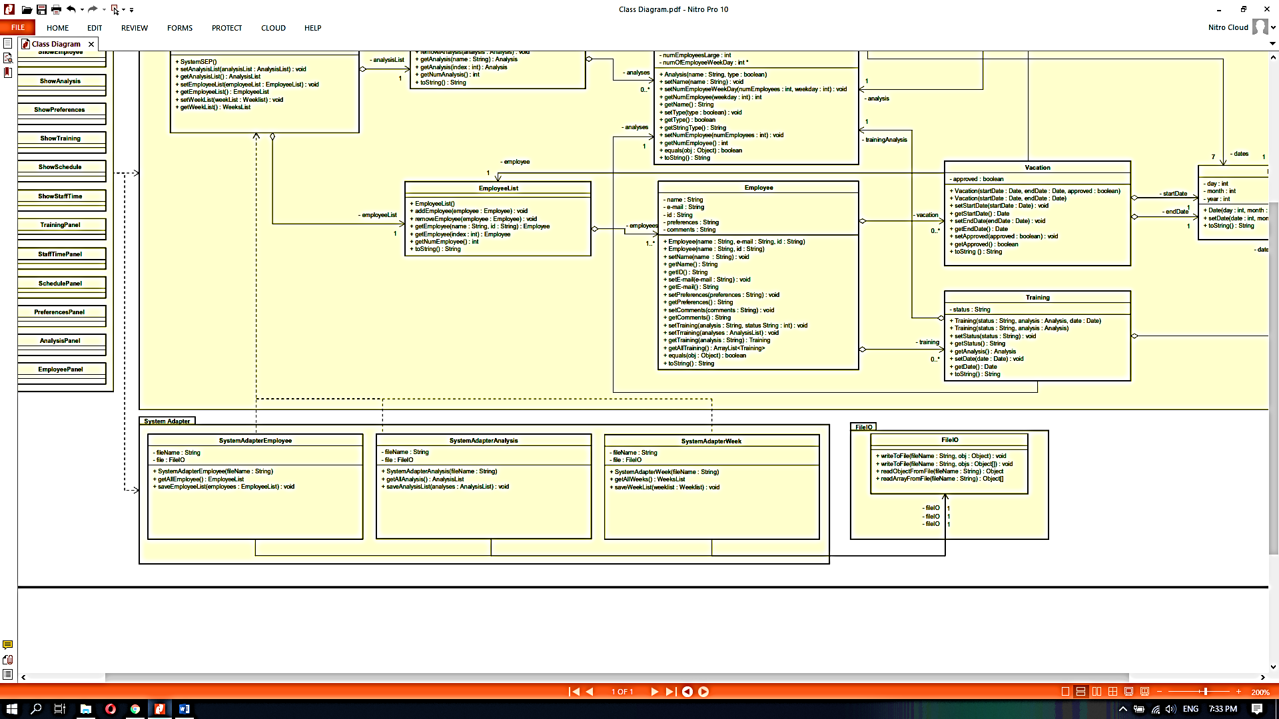
Class Diagram
List Classes
Task Classes
System Adapter and FileIO Classes

Slide 12
Sequence Diagram
From Whom?
What?
Who?

Slide 13

4. Implementation
From design to code

Slide 14
Main parts
In the implementation part the work was split in two main parts: the graphic user interface and the back-end
GUI
When developing the GUI for the system a lot of the things had to be learned and adjusted as we went along.
Back-end
When working on the functional part of the system, everything seemed simpler, until it needed to be connected with the GUI.

Slide 15
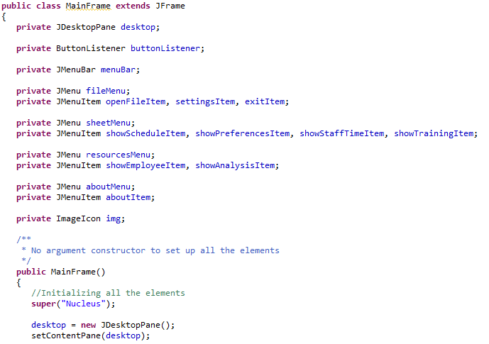
Important classes of the GUI
JDesktopPane() allowed us to be able to create a work-area where multiple windows (sheets) were opened. DesktopPane served as a parent to the sheets that were made as JInternalFrames rather than just JFrame.

Slide 16
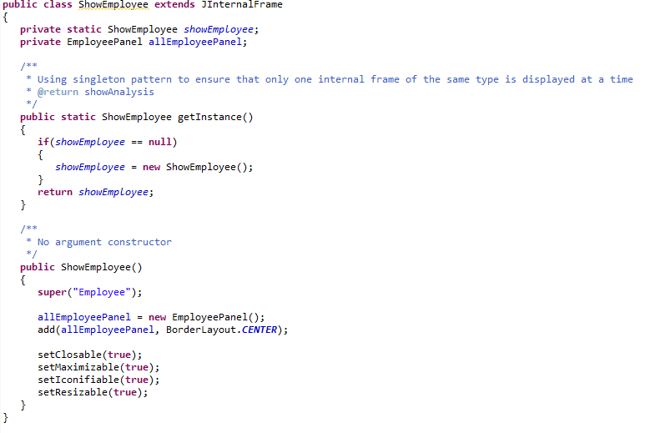
Some more on the GUI classes
For the sheets (JInternalFrame()) the singleton pattern was used to ensure that a window is not opened twice. The solution was inspired from stackoverflow.com forum.

Slide 17
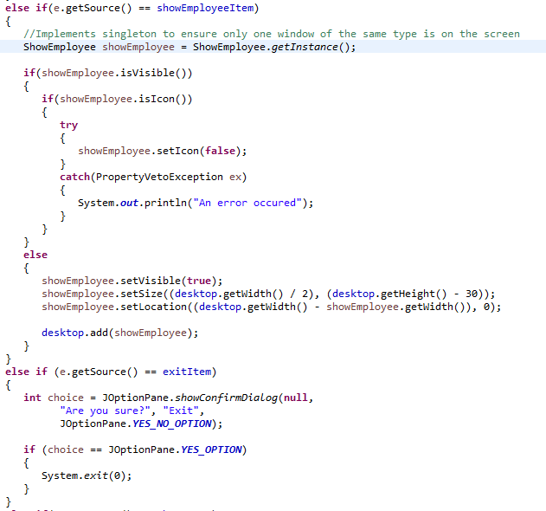
Some more on the GUI classes
Instead of creating a new instance of ShowEmployee internal frame the getInstance() method was used.

Slide 18
Testing
Requirement | Use Case
1 | Tested – Fully Functional
2 | Tested – Fully Functional
3 | Tested – Fully functional
4 | Tested – Functional
5 | Tested – Functional
6 | Tested – Functional
7 | Tested – Functional
8 | Tested – Functional
9 | Tested – Fully functional
10 | Tested – Not functional
11 | Tested – Fully functional
12 | Tested – Fully functional
13 | Tested – Functional
14 | Cannot be tested
15 | Cannot be tested
16 | Tested – Fully functional
17 | Cannot be tested
Fully Functional: 7/17
Functional: 6/17
Not Functional: 1/17
Cannot be tested: 3/17

Slide 19

5. Conclusion

Slide 20
Conclusion
Overall, the system does perform some of the main features; unfortunately, it cannot be used due to the absence of an integrated graphical user interface for the Schedule Sheet.
In the future, adding more functionalities to it, as well as integrating the existing functionalities with a graphical user interface would greatly improve its capabilities to truly become a work-planning tool.
Project Future

Slide 21

6. Process Report

Slide 22

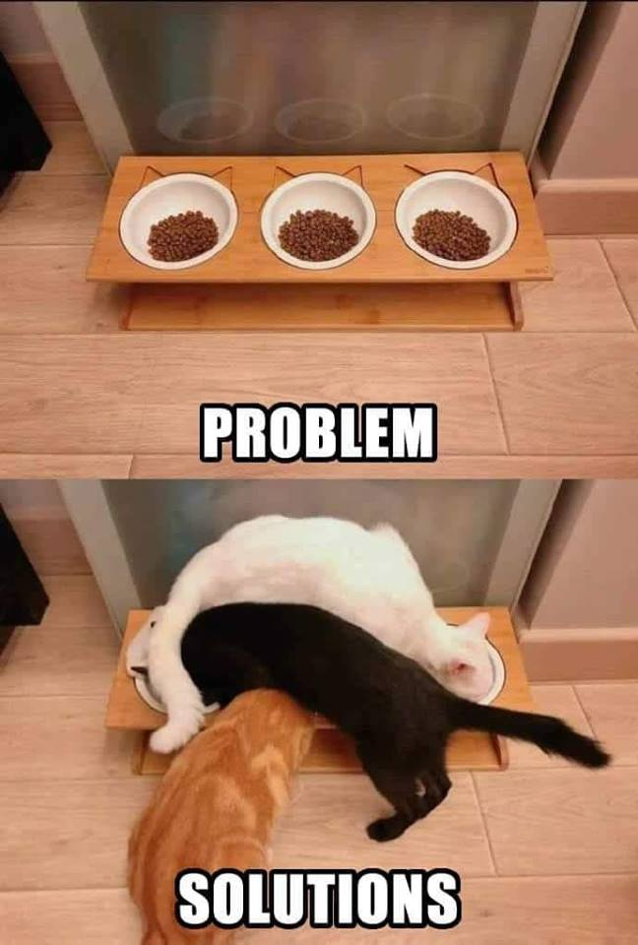
That is how it actually felt like

Slide 23
Let’s review some conclusions
The presented workload is real!
During the semester project we realized that we actually had to work more and still not be able to do everything that we indented to.
Do not try to do more than you can!
It is important to define your own delimitation not only the provided.
Group work is not easy, even with a nice group!
It is important to understand that different people work in different ways, have different visions and ideas.
Supervisors’ knowledge and guidance are very valuable, so use it!
Every time we were uncertain we asked and we got an answer, it would have been foolish to not rely on that.
Understand that Semester Project is a learning tool!
We did not think about the semester project as a learning project it made us falling into the idea that we can provide a fully functioning system that will solve all the issues presented in the case presentation.

Slide 24
Q & A
May the Alan Turing be with us.

